Slide 1
C# ASP.NET MVC
Lesson 1: Introduction to MVC

Slide 2
Today
Course Outline
Department Policies
Schedule
Introduction to ASP.NET MVC
Features of MVC 5
Controllers
Views
Models
Entity Framework & Seeding

Slide 3
Regarding Experience
Everyone in this class is at a different level
You will all take the same practical tests
If you are bored, speak to me about challenges
If you are overwhelmed, speak to me about extra help
Speak to each other most of all
Seriously

Slide 4
Course
Posted on Desire2Learn (LMS)
Log in to mylambton.ca
Go to Desire2Learn
Open Course 2022F-CSD-3354-01 – Web Applications Using C# .Net
Go to Lessons → Content
This material will be presented to you during this course, during this semester
Notes:
The most important skill of programmers is not

Slide 5
Description
The C# programming language is expanded upon and ASP.NET is introduced.
Students (1) implement web applications that follow the MVC architecture pattern by leveraging the ASP.NET MVC framework;
(2) build web applications that interface with databases through the use of Entity Framework;
(3) manage project dependencies with NuGet package manager; and
(4) test applications with unit tests.
Notes:
The most important skill of programmers is not

Slide 6

Textbook
Professional ASP.NET MVC 5
https://www.wiley.com/en-us/Professional+ASP+NET+MVC+5-p-9781118794753
You should have this textbook
Many of your in-class exercises and homework assignments will come from the back-of-chapter questions
Although I hop around, I stick pretty close to the book in this course and it’s a good resource
$30! Wow, that’s surprisingly affordable.
Your resources are limited during tests and exams to notes, physical books and e-books (with receipt)
It’s also a really good book, you should read it
Notes:
The most important skill of programmers is not

Slide 7
Course Evaluation
5 Assignments
5% each
3 Major Tests
25% each
Notes:
The most important skill of programmers is not

Slide 8
Program Policies
Late Dropbox Submissions - Dropboxes are not opened for late submissions. Students are permitted two (2) late dropbox submissions for each course per term. A late dropbox submission results in a fifty (50%) percent penalty…
Excusakle Waiver …
Notes:
The most important skill of programmers is not

Slide 9
Academic Integrity
“The cornerstone of academic integrity and professional reputation is professional conduct.”
“All scholastic and academic activity must be free of all forms of academic dishonesty, including copying, plagiarism and cheating.”
“When you cheat, the only person you’re cheating is yourself. Don’t be a jerk to yourself.”
Notes:
The most important skill of programmers is not

Slide 10
Other Concerns
Students with Disabilities
Please contact Accessibility
Student Rights and Responsibilities
It is your responsibility to know your rights
International Student Withdrawal Deadline
September 19th, 2022
Date of Withdrawal without Academic Penalty
November 18th, 2022
Study Week – No classes
October 24th to 28th, 2022
Exam Week
December 12th to 16th, 2022
Notes:
The most important skill of programmers is not

Slide 11
Course Quiz
Congratulations!
You are now prepared to start the course.
Most of your courses will have a Course Quiz
Takes 10 Minutes
Do Quiz or Take Break or Study Ahead
We will continue in 10 minutes sharp
Notes:
The most important skill of programmers is not

Slide 12
What is ASP.NET MVC?
ASP.NET MVC is a web application framework developed by Microsoft
MVC (Model View Controller) is a software architectural pattern
Divides an application into three logical components
MVC 5 is the last official release, it has since been unified into ASP.NET Core
Notes:
The most important skill of programmers is not

Slide 13
Features of MVC 5
Bundling
Bootstrapping
ASP.NET Identity
Attribute Routing
Scaffolding
Notes:
This repeatable set of instructions is called an algorithm.

Slide 14
Controllers
What is a controller
Handle and respond to user requests
Communicates with the Models and decides which views to return
Handle overall flow of application

Slide 15
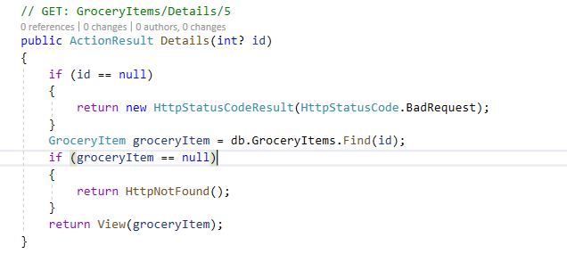
Controllers
Controllers in ASP.NET MVC
Return a View (ActionResult)
Can take optional parameters (Passed through URL/Route or payload)

Slide 16
Views
What is a View
Dynamically generated HTML
Application UI
Not Directly Accessible

Slide 17
Views
Views in ASP.NET MVC
Razor is the view engine that is used to generate CSHTML
Is HTML Encoded to prevent XSS
ViewBag allows you to pass data from the Controller to the View
ViewBag is a dynamic ViewData Dictionary
ViewBag.Key == ViewData["Key"]
Can Be scaffolded
Various tempaltes (ie, Create, Delete, Edit)

Slide 18
Views
Scaffolding – Default Templates
Scaffold | Description
Create | Creates a view with a form for creating new instance of a model, complete with a label and input field for each property of the model
Delete | Creates a view with a form for deleting an existing instance of a model
Details | Creates a view that displays a label and value of each property of the model
Edit | Creates a view with a form for editing the properties of an existing model instance
Empty (With and without a model) | Creates an Empty View with the option of strongly typing the model with @model syntax
List | Creates a view with a table of model instances, expects IEnumerable<Model> as input

Slide 19
Views
Partial Views
Partial Views behave the same as a view, but will not invoke _Layout unless specified
Can be returned by a controller to insert new HTML

Slide 20
Model
What is a Model
A class the represents an object in the database
Describes the domain
Encapsulates the application and business logic
Serves as a Data Access Layer
Often combined with Tooling like Entity Framework and NHibernate

Slide 21
Model
Models and Entity Framework – Code First
EF will assume a property named ID is the primary key, unless otherwise specified with [Key] Attribute
EF will assume the table name will match the model name, unless specified with [Table("name")] Attribute
DBContext is the gateway to the Database

Slide 22
Entity Framework
What is Entity Framework?
Object-Relational Mapping Framework
Stores .NET Objects in a Database
Can be queried using LINQ

Slide 23
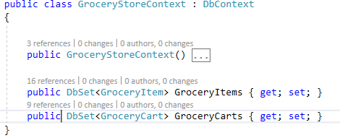
Entity Framework
DbContext
The derived class contains one or more DbSet<T>
T is a Generic for the type of Object we want to persist
Each DbSet is a data aware generic list that knows how to transac data of the Generic type with the database

Slide 24
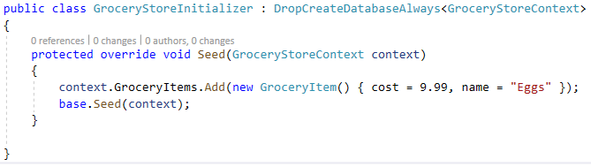
Entity Framework
Initializers - Seeding Test Data
Data can be initialized at App Start
In Global.asax, import System.Data.Entity to set the database initializer
Database.SetInitilizer(new OurInitializer());
Deriving from DropCreateDatabaseAlways will force the context to drop any existing data and recreate it from the seed

Slide 25
Demonstration

